Slide 1
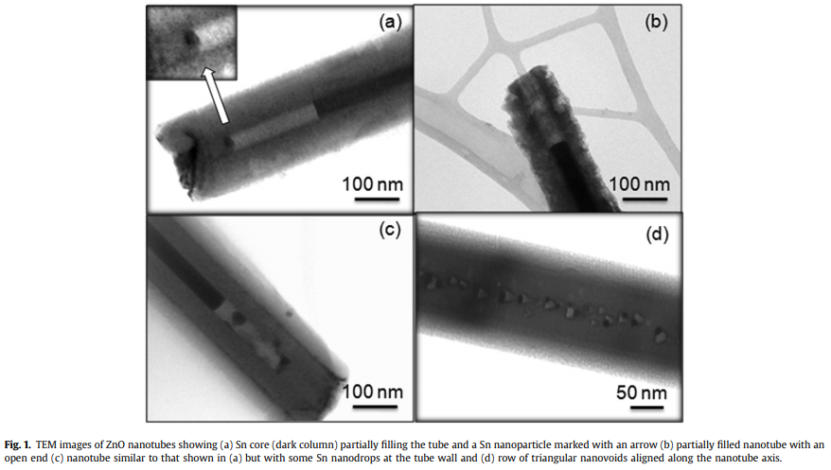
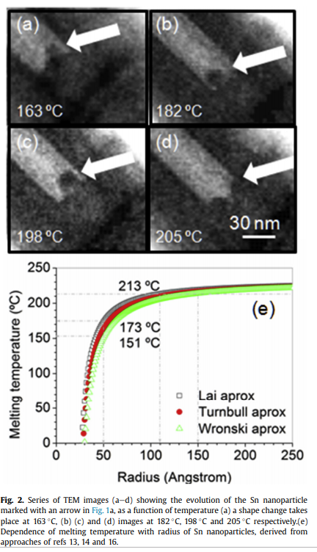
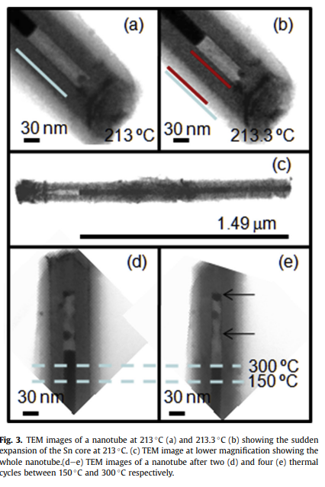

In-situ transmission electron microscopy study of melting and diffusion processes at the nanoscale in ZnO nanotubes with Sn cores
Objective
Understand the thermal behaviour of ZnO nanotubes partially filled with Sn cores, containing also Sn nanoclusters and nanovoids by in-situ heating treatments in a transmission electron microscope (TEM)
Procedure
TEM studies were carried out with a Philips CM200 equipped with a 652 Gatan double tilt heating holder. To study Sn melting temperature of nanoparticles or the expansion of a Sn nanocolumn inside a nanotube, the sample was heated at 20 or 10 C/min up to about 250 C. Moreover to investigate diffusion processes, heating at a rate of 5 C/min was performed during observation in TEM to 640 C.e
Conclusion
The melting temperature of Sn nanoclusters and cylindrical nanocores has been found to be lower than the bulk melting temperature of Sn in agreement with previous theoretical estimation of several authors for nanoclusters

